Slide 1


K-means and the Telco Churn Case (part 1)
Wake Forest
School of Business
_______
BAN 6025

Slide 2

Telco Churn Case (Review)

Slide 3
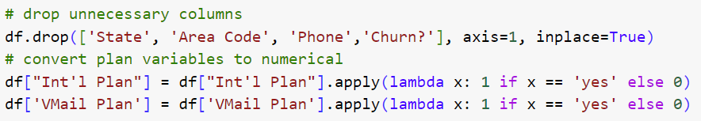
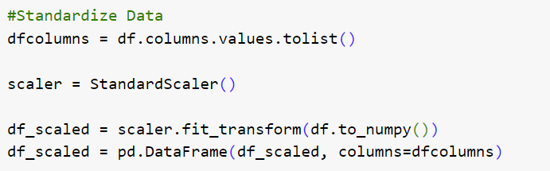
Initial Data Prep for Clustering

Slide 4
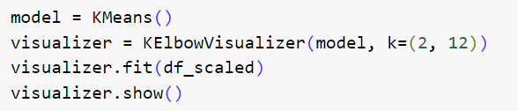
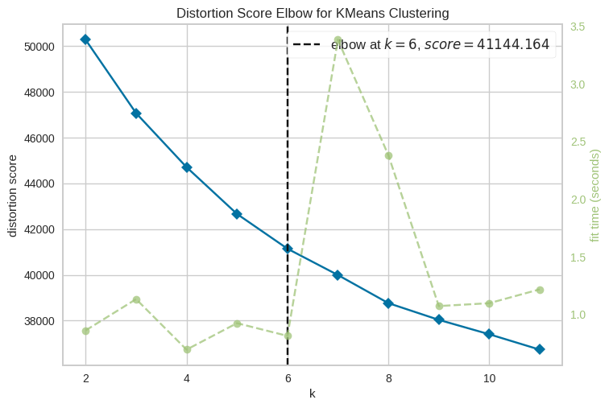
How Many Clusters?

Slide 5
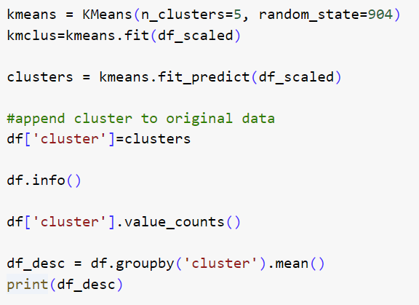
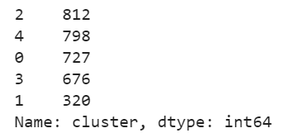
Creation and Initial Evaluation of Clusters

Slide 6
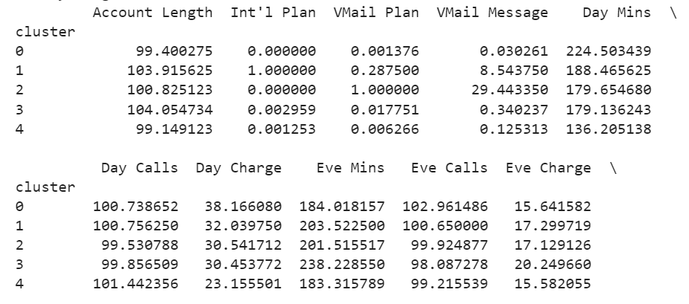
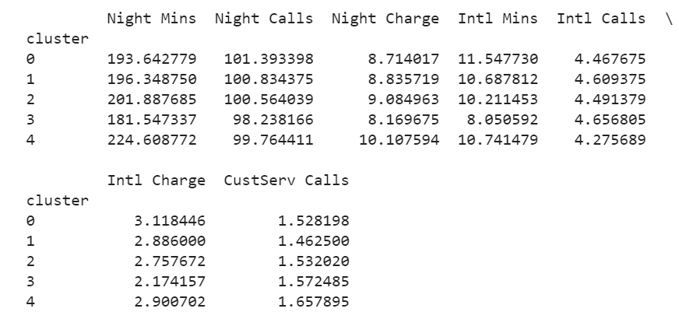
Initial Evaluation of Clusters

Slide 7
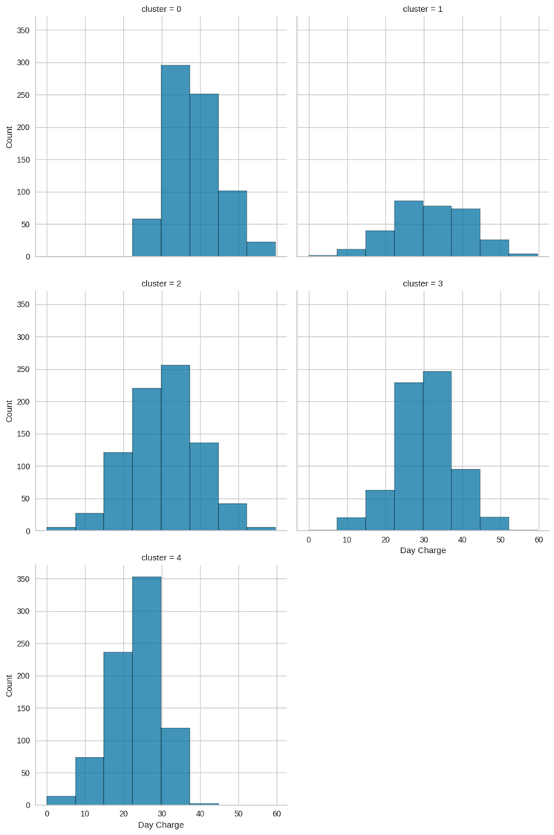
Cluster Profiling: Day Charges
Cluster | Mean | Median | Min | Max
0 | 38.17 | 37.52 | 22.83 | 59.64
1 | 32.04 | 32.13 | 2.13 | 58.96
2 | 30.54 | 30.84 | 0.44 | 54.81
3 | 30.45 | 30.38 | 5.78 | 56.59
4 | 23.16 | 23.76 | 0.00 | 40.78

Slide 8
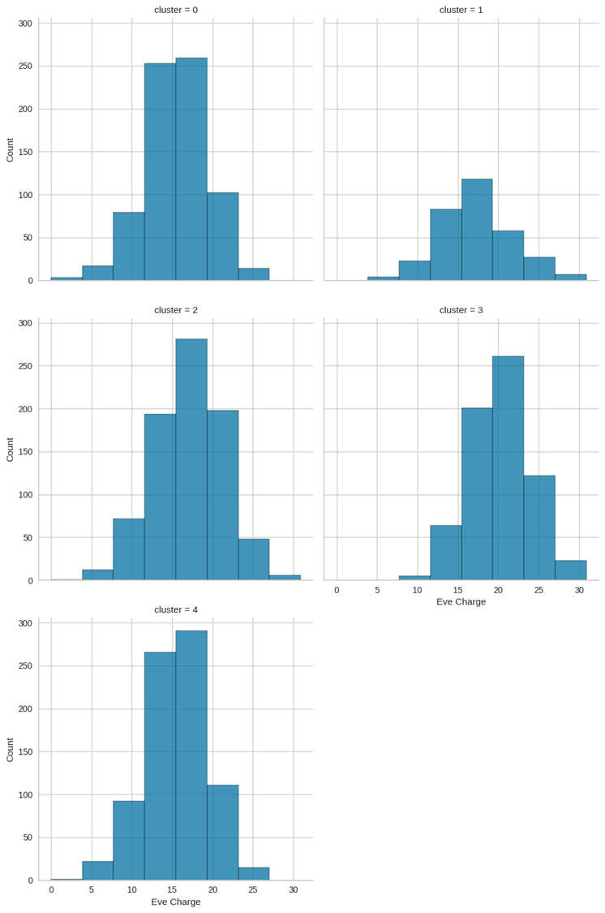
Cluster Profiling: Evening Charges
Cluster | Mean | Median | Min | Max
0 | 15.64 | 15.77 | 0.00 | 26.89
1 | 17.30 | 17.17 | 5.17 | 30.91
2 | 17.13 | 17.32 | 3.59 | 29.01
3 | 20.25 | 20.42 | 10.23 | 30.75
4 | 15.58 | 15.78 | 3.73 | 25.15

Slide 9
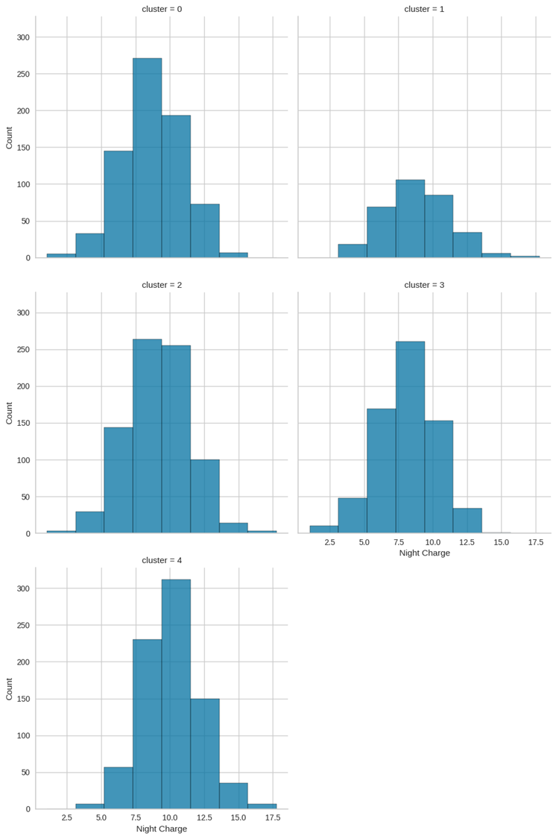
Cluster Profiling: Night Charges
Cluster | Mean | Median | Min | Max
0 | 8.71 | 8.63 | 2.25 | 14.50
1 | 8.84 | 8.85 | 3.26 | 15.86
2 | 9.08 | 9.15 | 1.04 | 17.17
3 | 8.17 | 8.22 | 1.97 | 14.04
4 | 10.11 | 10.13 | 4.09 | 17.77

Slide 10
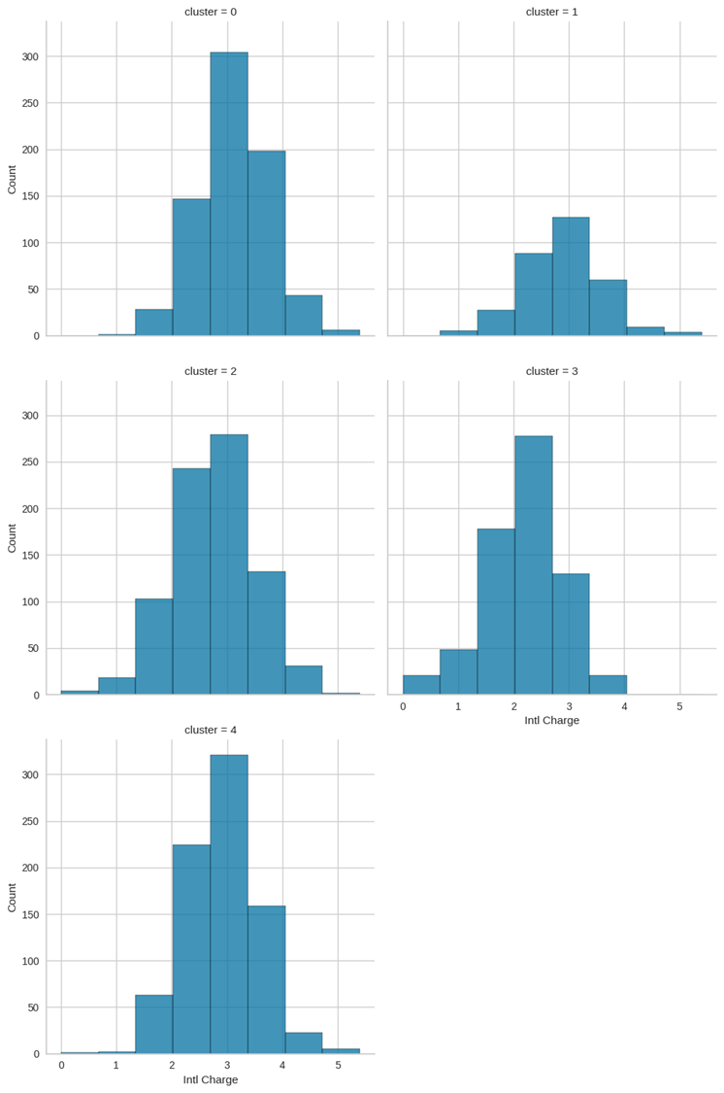
Cluster Profiling: Intl Charges
Cluster | Mean | Median | Min | Max
0 | 3.12 | 3.11 | 1.27 | 4.97
1 | 2.89 | 2.92 | 0.97 | 5.40
2 | 2.76 | 2.75 | 0.00 | 4.75
3 | 2.17 | 2.24 | 0.00 | 3.81
4 | 2.90 | 2.89 | 0.00 | 5.10

Slide 11
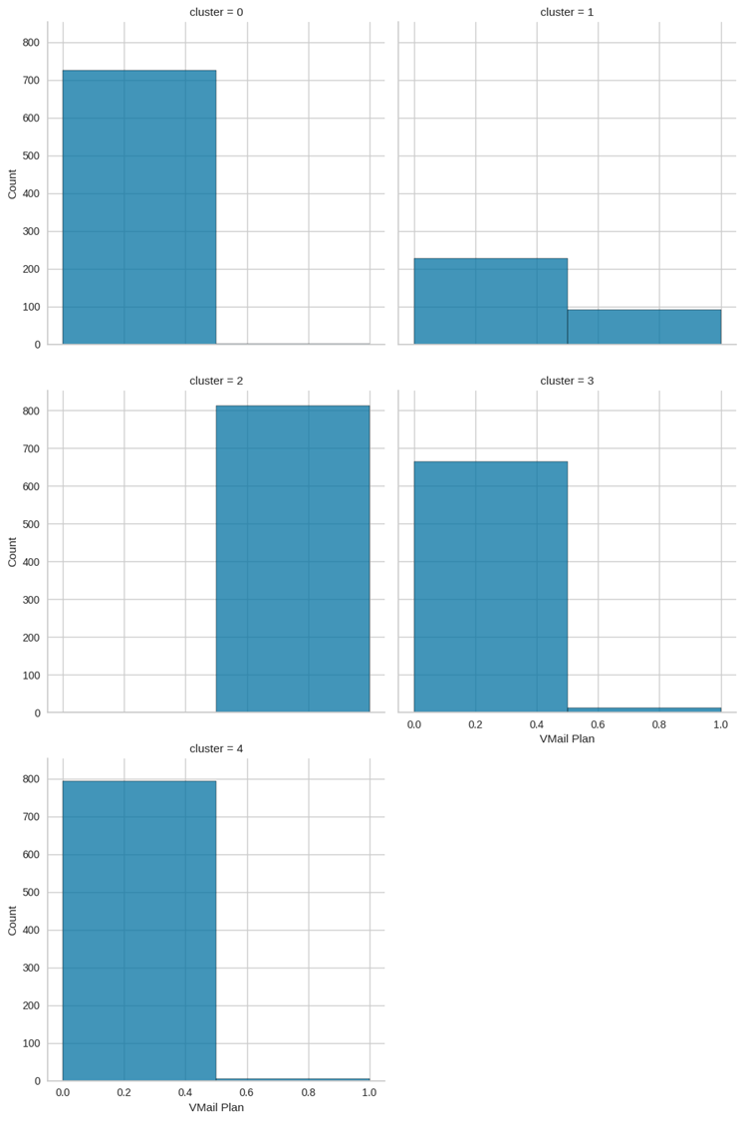
Cluster Profiling: Vmail Plan

Slide 12
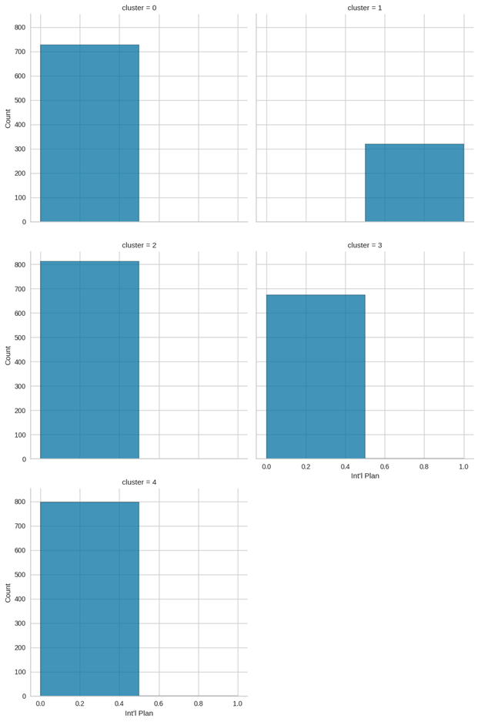
Cluster Profiling: Intl Plan

